Slide 1
Introduction to Next Generation sequencing (NGS)
Haibo Liu
Iowa State University

Slide 2
Outline
NGS technologies and their applications
Sequencing depth and coverage
Common NGS file formats
Common tools for NGS data analysis

Slide 3
Why do we sequence?
Resequencing
Variant discovery
Counting
Copy number variation
Gene/transcripts expression quantitation
Species/OTU abundance (Metagenomics)
…
Genome or Transcriptome Assembly

Slide 4
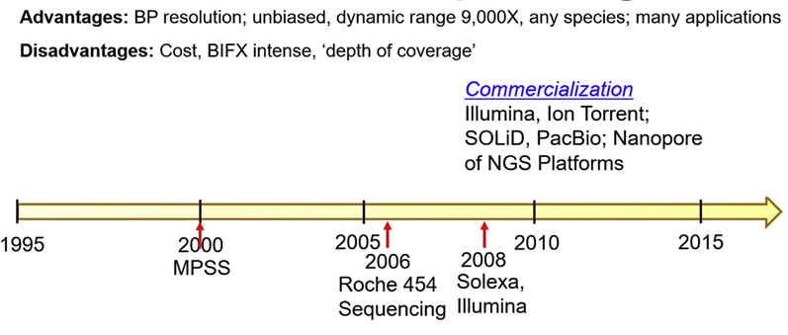
History of Sequencing
Sanger Sequencing
(Modified from Bruce Alexander Merrick, 2019)

Slide 5
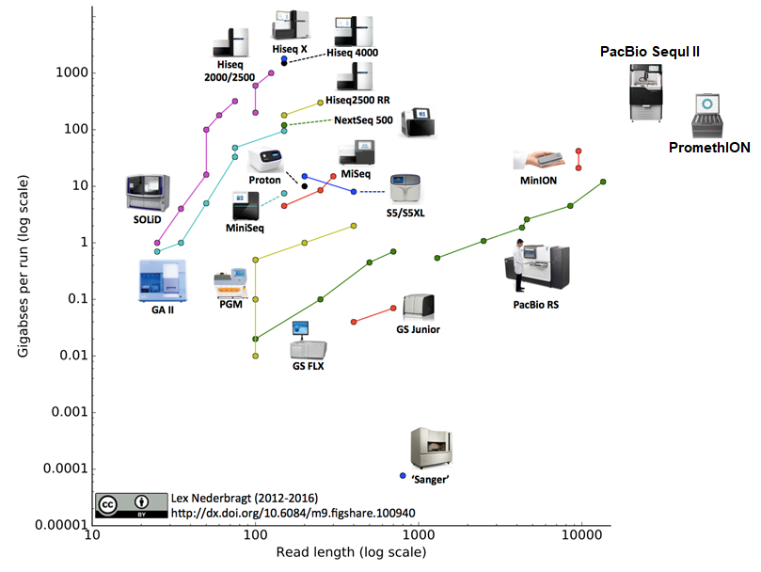
Sequencing Platforms, Read length and Throughput
2nd generation sequencing
3nd generation sequencing
Further reading: Goodwin et al. Nat Rev Genet. 2016, 17(6):333-51.

Slide 6
A movie of Illumina sequencing
https://www.youtube.com/watch?v=fCd6B5HRaZ8

Slide 7
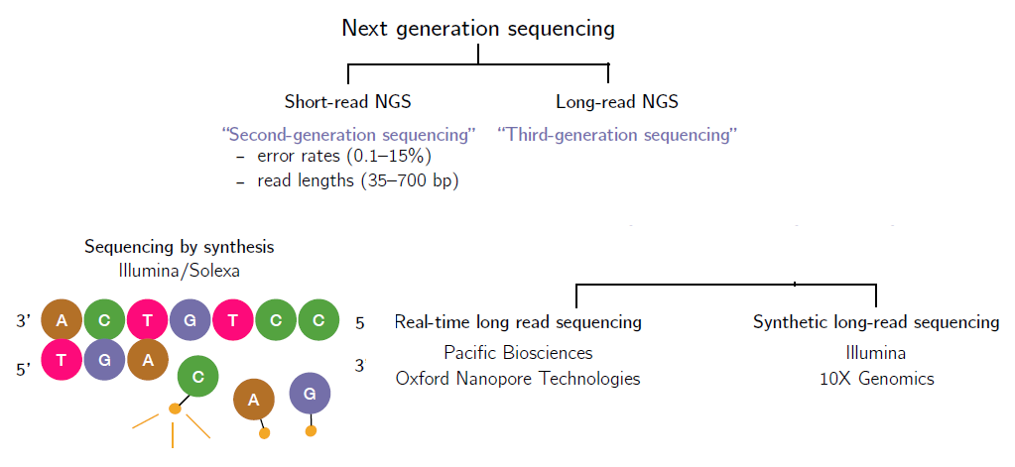
Classification of NGS technologies
-error rates (5 -15%)
-read length (Kb –Mb)

Slide 8
Type of sequencing strategies
Shotgun sequencing: Sequencing everything at random (shotgun sequencing) is much easier than sequencing a specific gene region (Lander-Waterman).
Targeted sequencing:
Amplicon sequencing
Exome-seq
Hybrid

Slide 9
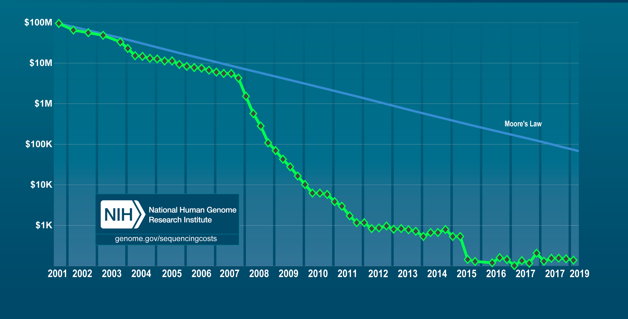
Sequencing cost per human genome over 20 years

Slide 10
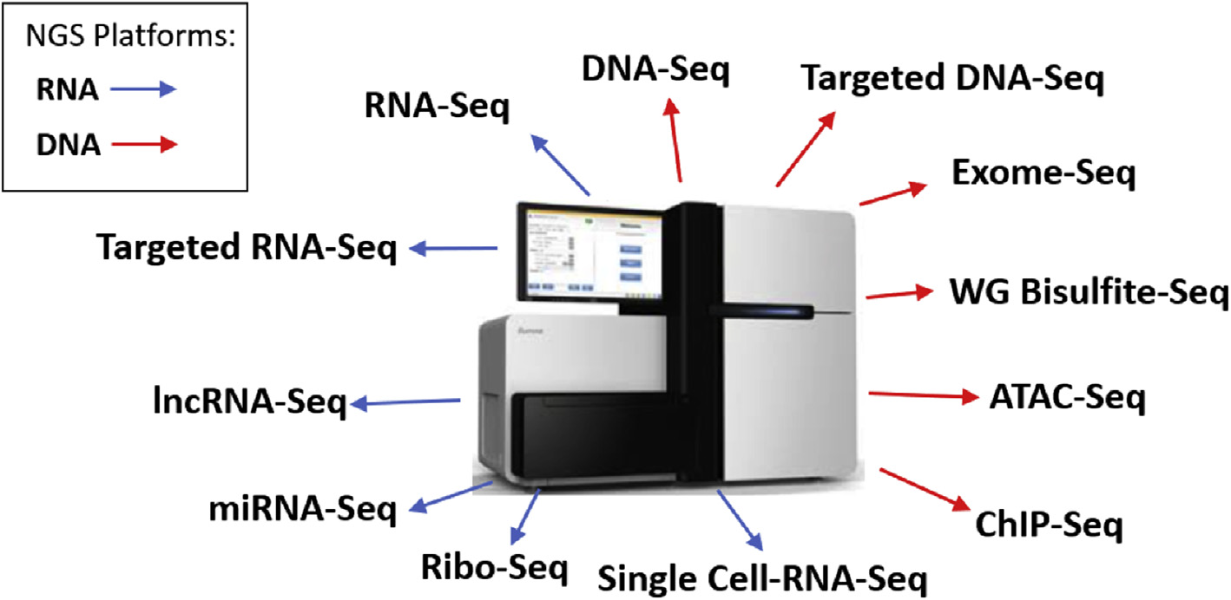
Many applications of NGS
(Bruce Alexander Merrick, 2019)

Slide 11
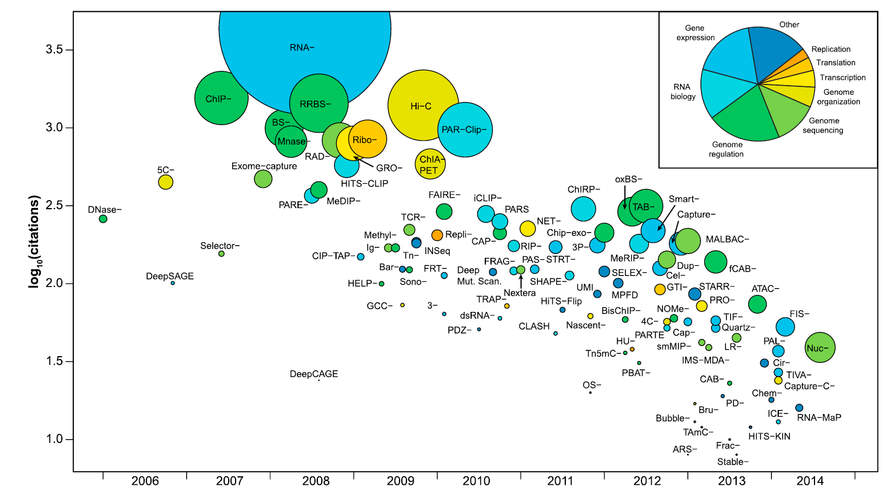
Broad overview of HTS applications
Dot size ~ publication rate (citation/month)
Reuter et al. Mol Cell. 2015(58)4:586-97.

Slide 12
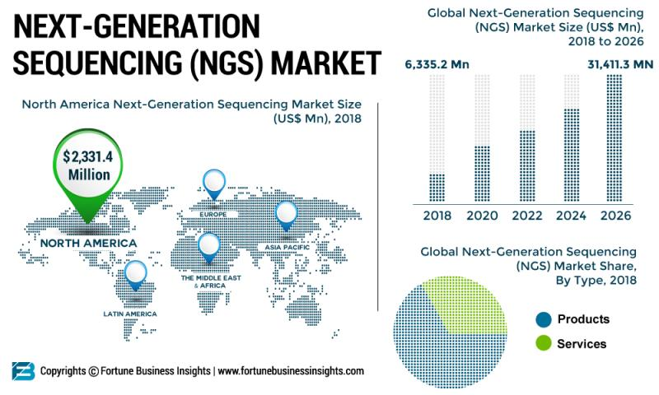
Global NGS market prediction
https://www.openpr.com/news/1842450/why-the-next-generation-sequencing-market-is-set-to-explode-top

Slide 13
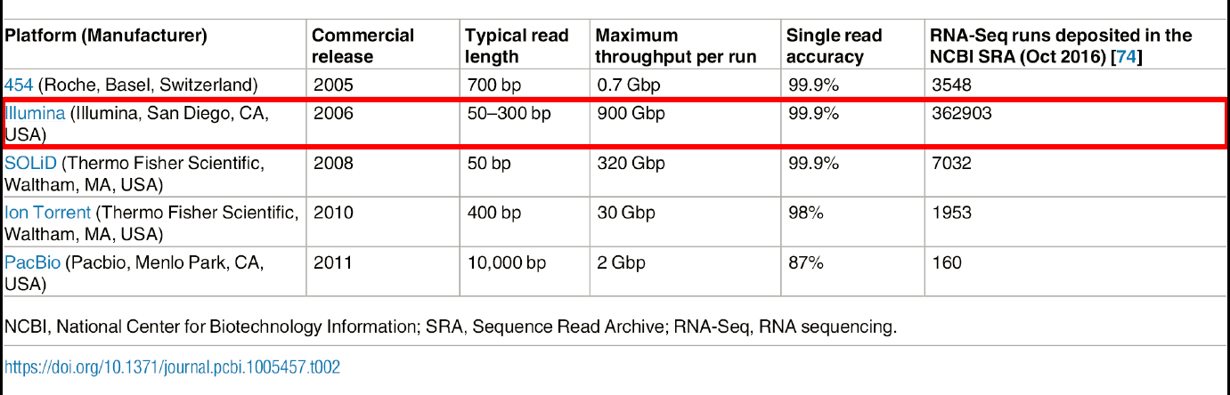
Illumina is the most popular platform for RNA-seq
Direct RNA sequencing (Nanopore) is emerging.

Slide 14
Outline
NGS technologies and their applications
Sequencing depth and coverage
Common NGS file formats
Common tools for NGS data analysis

Slide 15
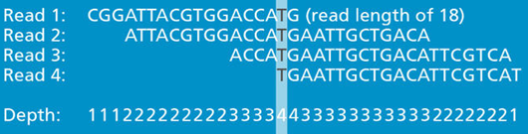
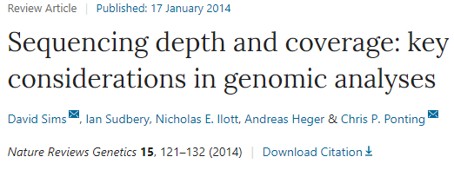
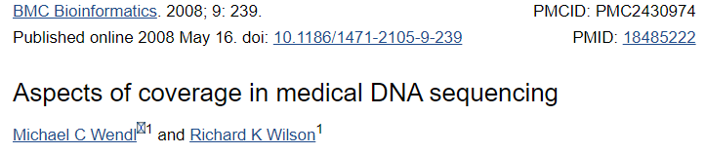
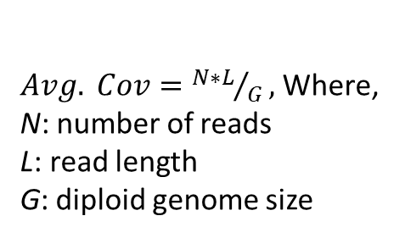
Two important sequencing terminology: Depth and Coverage
Depth in DNA sequencing is the number of unique reads that overlap each true base in genome.
$Avg. Cov={N∗L}/G,$Where,
N: number of reads
L: read length
G: diploid genome size
Coverage: average number of reads of a given length that align to or ‘cover’ known reference bases with the assumption that the reads are randomly distributed across the genome.
Breadth of Coverage: the percentage of target bases that have been sequenced for a given number of times.
Empirical recommendation by Illumina: https://genohub.com/recommended-sequencing-coverage-by-application/

Slide 16
Problems with the random sampling assumption
Not all sequence is as easily sequenced as other, depending on your sequencing technology (e.g. GC/AT bias);
Some RNA not be as accessible as others (secondary structure);

Slide 17
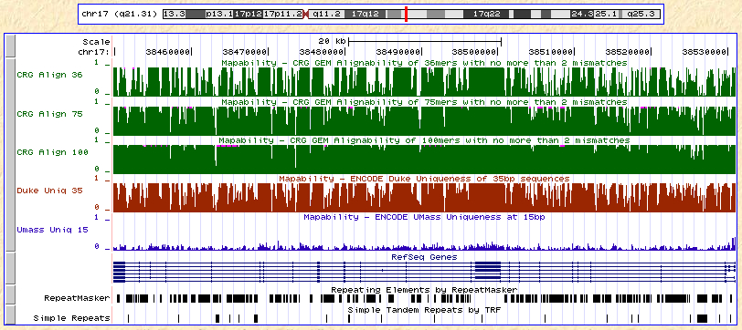
Issues inherent to short read mapping
• Not all of the genome is ‘available’ for mapping when reads are aligned to the unmasked genome.
• Mappability: This provide a measure of how often the sequence found at the particular location will align within the whole genome.
• Uniqueness: This is a direct measure of sequence uniqueness throughout the reference genome.
Mappability with 36, 75, and 100bp reads as calculated by CRG-GEM (https://biocore.crg.eu/wiki/GEM_Mapper)
Effective genome size (ChIP-seq analysis)

Slide 18
Random sampling => deep sampling needed
Typically 10-100x needed for robust recovery (300 Gbp for human)
Clinical grade resequencing: 30X coverage.

Slide 19
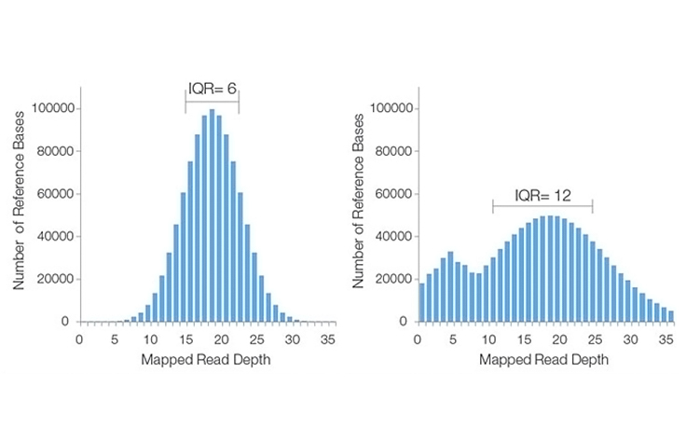
Examples of distributions of genome sequencing depth
Good
Poor

Slide 20
Decision making related to sequencing depends on problems of interest
Coverage matters for SNP calls and assembly;
Number of reads matters for counting;
Length of reads matters for reconstructability (assembly & haplotyping);
Platform selection:
Illumina is still the “best” for high coverage;
Short reads for gene expression profiling and genotyping
Synthetic long reads for haplotyping
PacBio and NanoPore long reads for best contiguity;
genome assembly
Isoform sequencing

Slide 21
Outline
NGS technologies and their applications
Sequencing depth and coverage
Common NGS file formats
Common tools for NGS data analysis

Slide 22
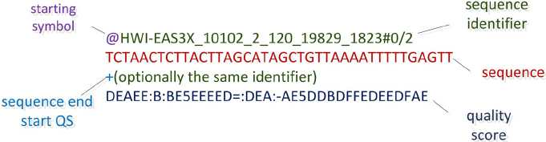
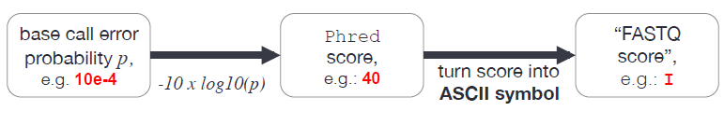
Your basic sequencing data: FASTQ
Old fastq
Recent fastq
Phred score for Base quality
A detailed explanation of FASTQ file format: https://en.wikipedia.org/wiki/FASTQ_format

Slide 23
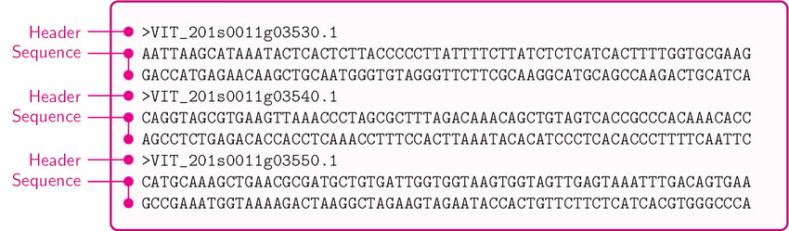
FASTA format

Slide 24
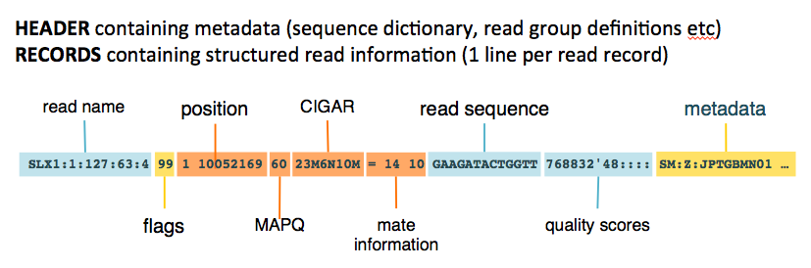
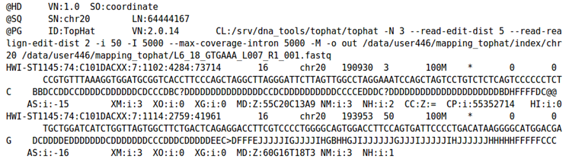
Sequence Alignment/Map (SAM) and BAM File Formats
More details: http://www.metagenomics.wiki/tools/samtools/bam-sam-file-format

Slide 25
CRAM file
Reference-based compression technique for storage of big alignment files
1. Reads are first aligned to the reference
2. Unaligned reads are pooled to create a specific “compression framework” for this data set
3. The base pair information is stored using specific offsets of reads on the reference, with additional information
Fritz et al, 2011. Genome Res. 21:734-740

Slide 26
File formats of Bed, GTF, GFF, bigWig, …
For details, please refer to UCSC genome browser documents: https://genome.ucsc.edu/FAQ/FAQformat.html#format4

Slide 27
Outline
NGS technologies and their applications
Sequencing depth and coverage
Common NGS file formats
Common tools for NGS data analysis

Slide 28
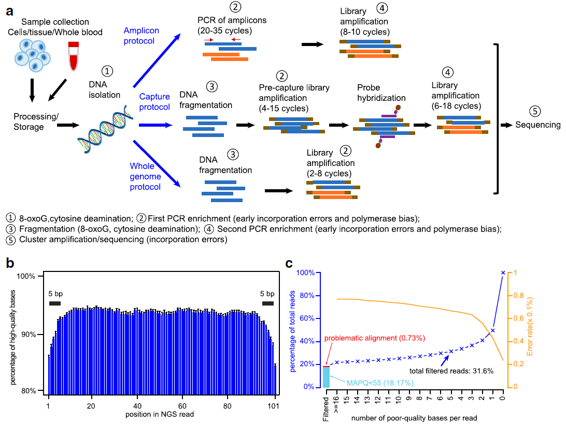
Potential error sources in NGS workflow
Ma X et al. Genome Biol 20, 50 (2019) doi:10.1186/s13059-019-1659-6

Slide 29
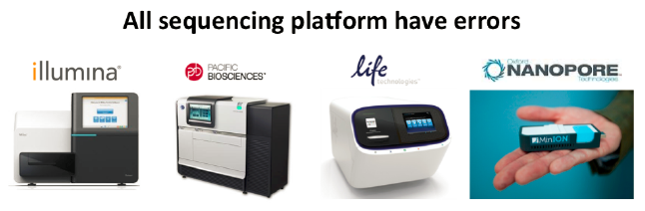
Quality Control is Critical

Slide 30
Tools for quality control of raw sequencing data
FASTQC + MultiQC:
Simon Andrews https://www.bioinformatics.babraham.ac.uk/projects/fastqc/
Ewels et al. 2016, https://multiqc.info/
FASTP: an ultra-fast all-in-one FASTQ preprocessor (Chen et al. 2018)
FastqPuri: high-performance preprocessing of RNA-seq data (Pérez-Rubio et al. 2019)
Many others

Slide 31
QC workflow of sequencing data
Critical to perform QC before real analysis!!!
Preprocessing: Optional
Remove adapter sequences
Remove low-quality bases
Remove too short reads (< 25 bp)
Raw sequencing data
QC
Data clean (Preprocessing)
QA
Downstream analysis

Slide 32
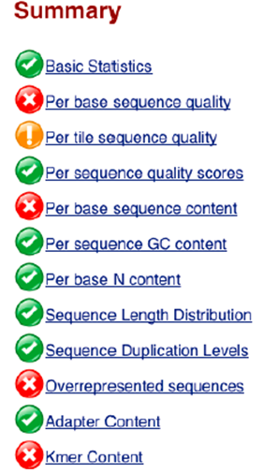
Interpretation of FASTQC reports
1. Run FASTQC
2. Open HTML QC report or synthesize a MultiQC report for multiple fastq files
For detailed explanation to each metric, see https://www.bioinformatics.babraham.ac.uk/projects/fastqc/Help/3%20Analysis%20Modules/

Slide 33
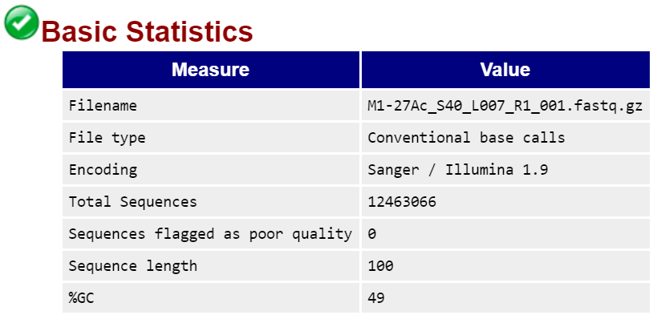

Slide 34
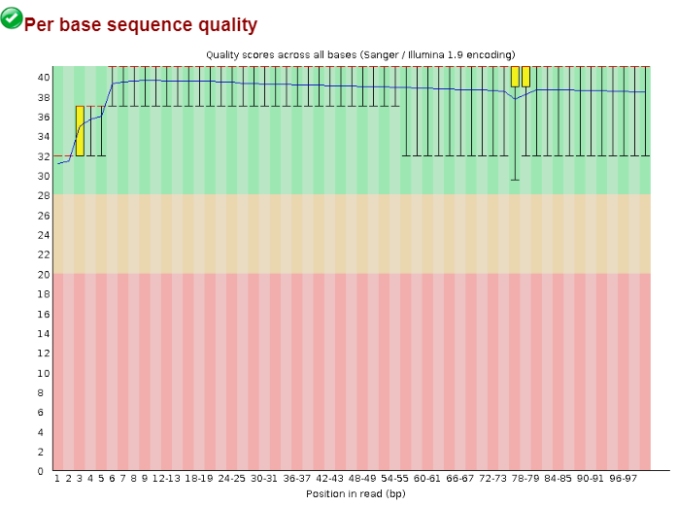
Per base sequence quality
Quality Range
Very good
quality
Fairly good
Poor

Slide 35
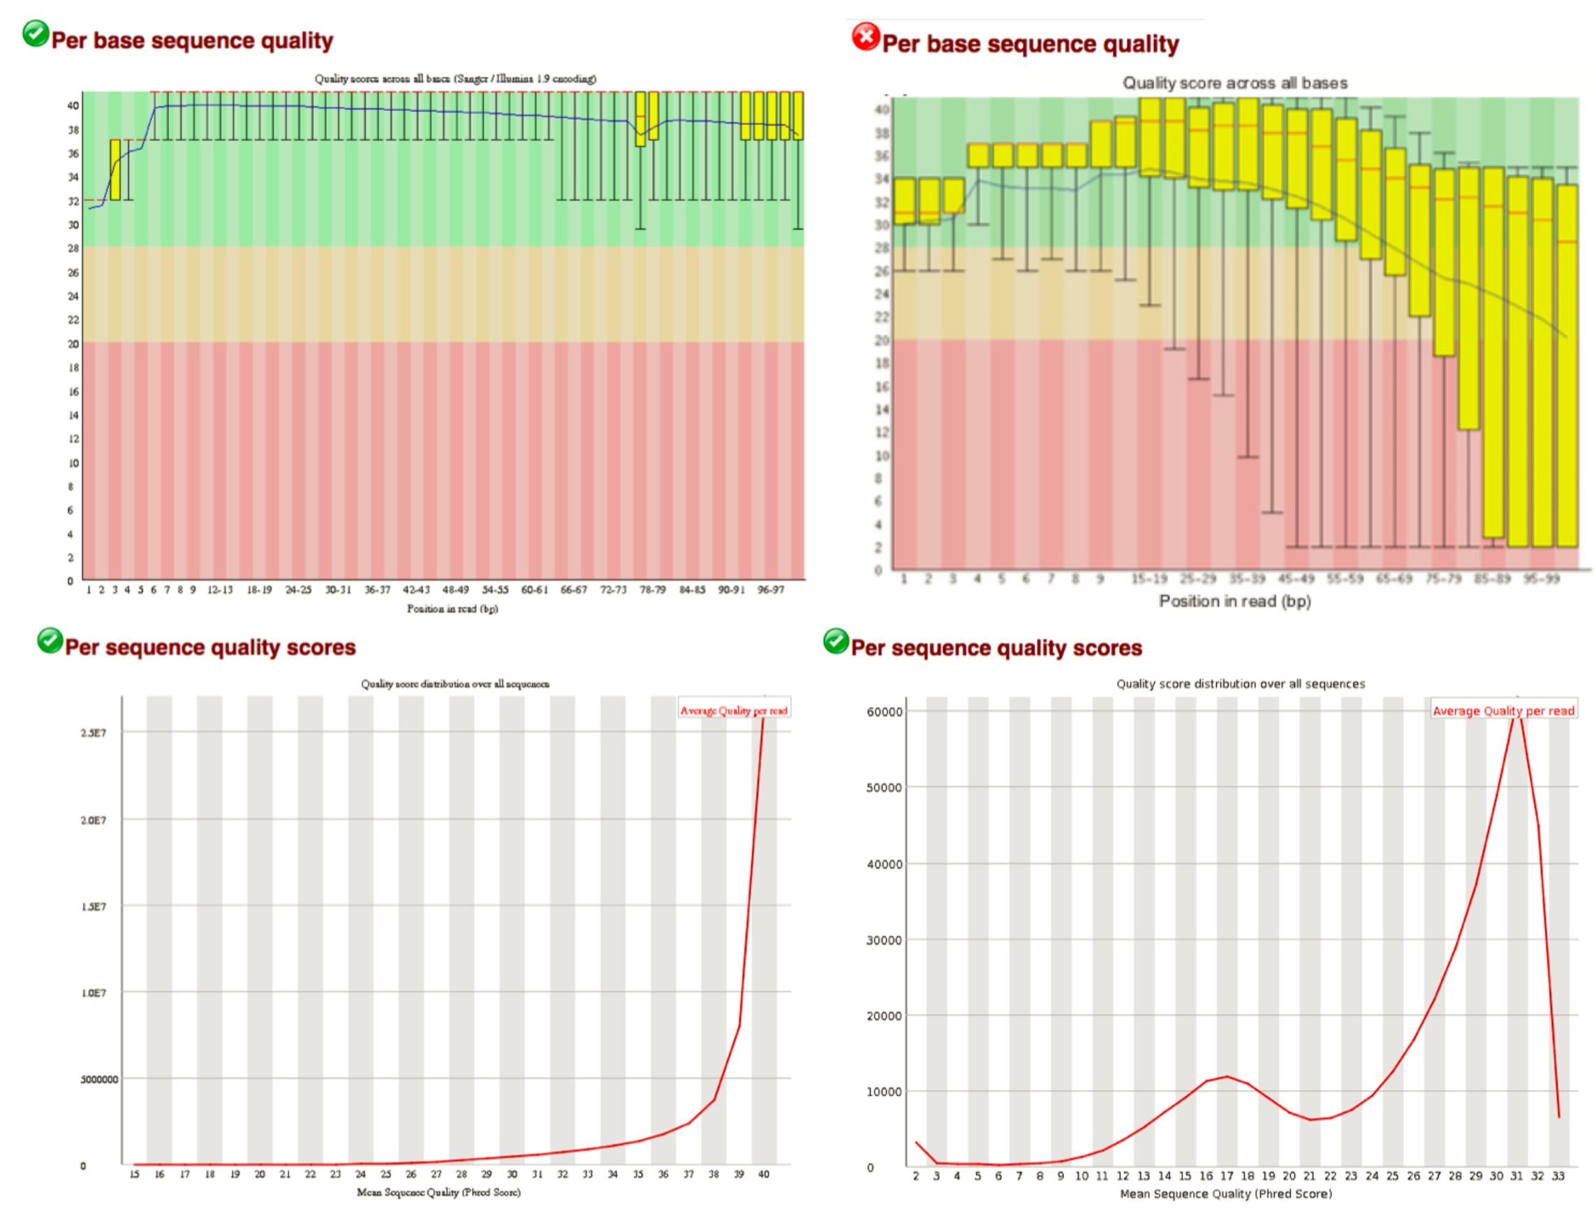
Base-wise and overall sequence quality

Slide 36
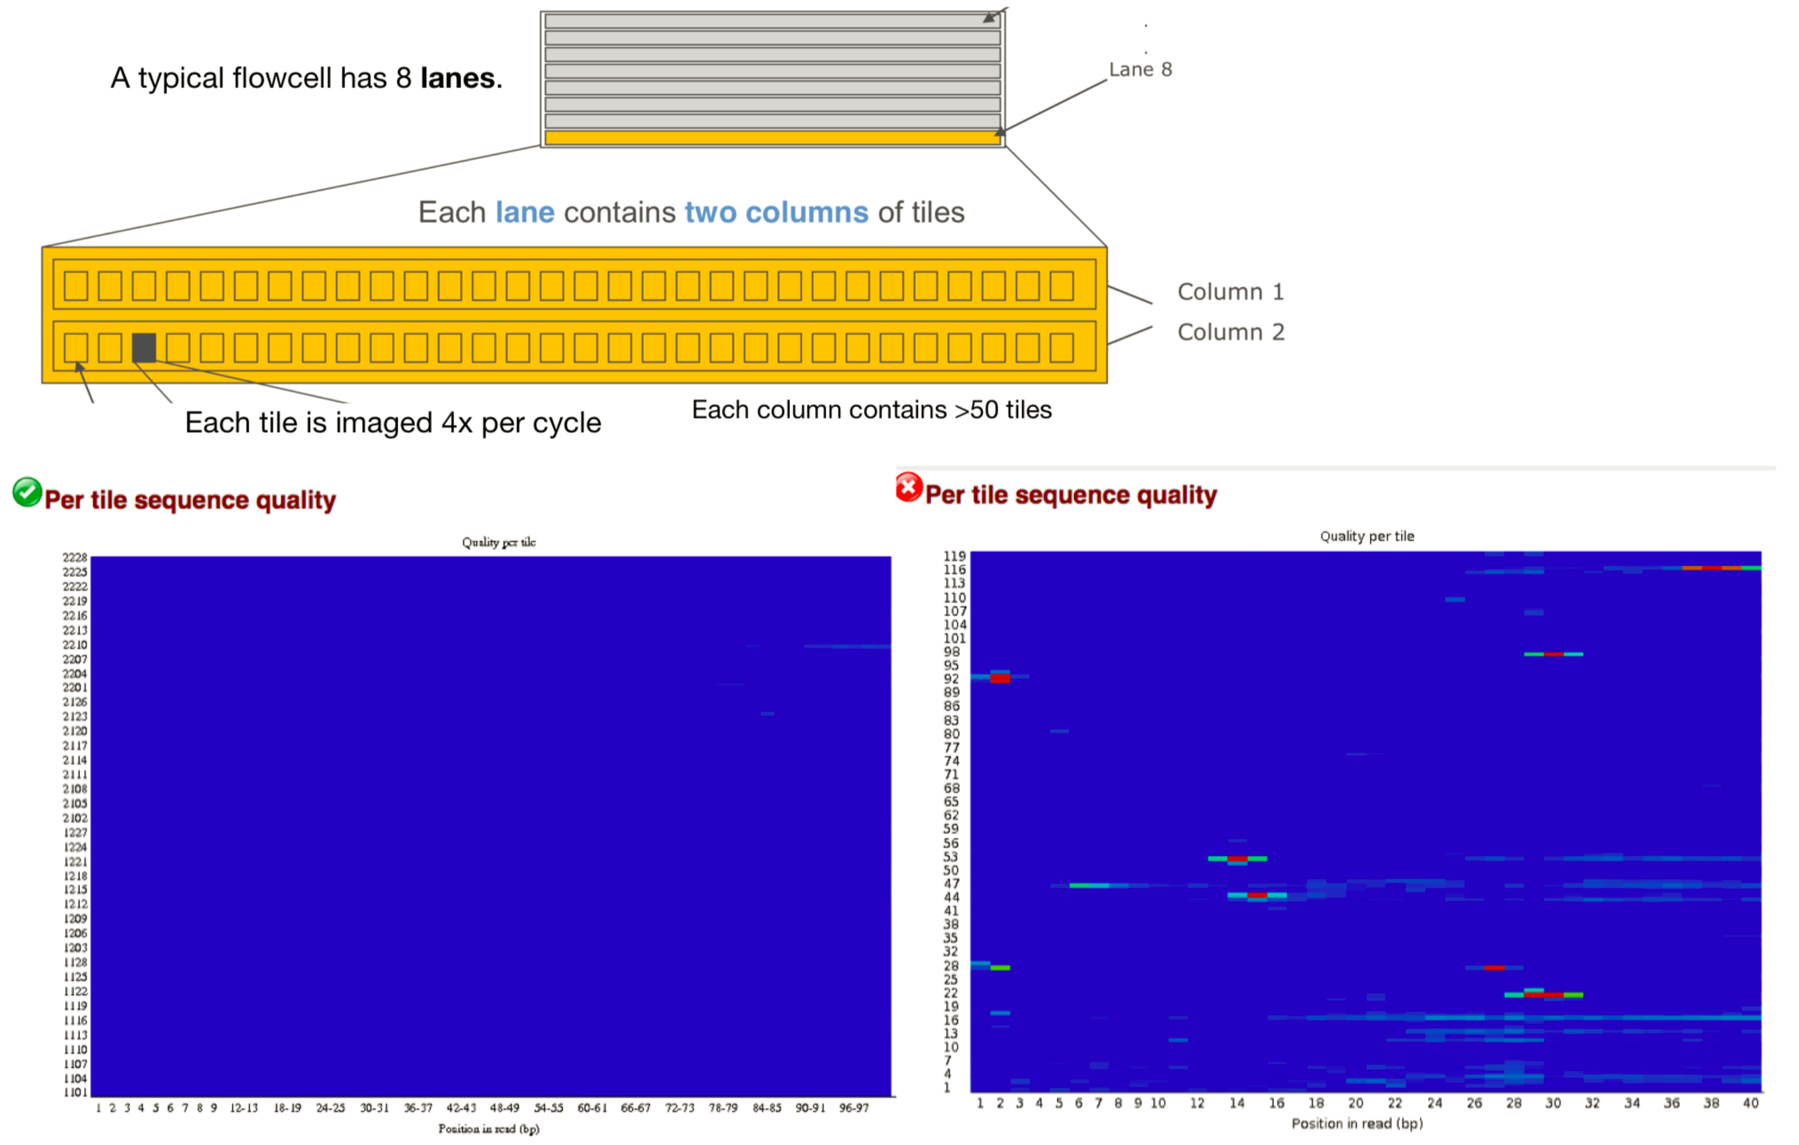
Per tile quality
https://chagall.med.cornell.edu/RNASEQcourse/Slides_Nov2019_Day2.pdf

Slide 37
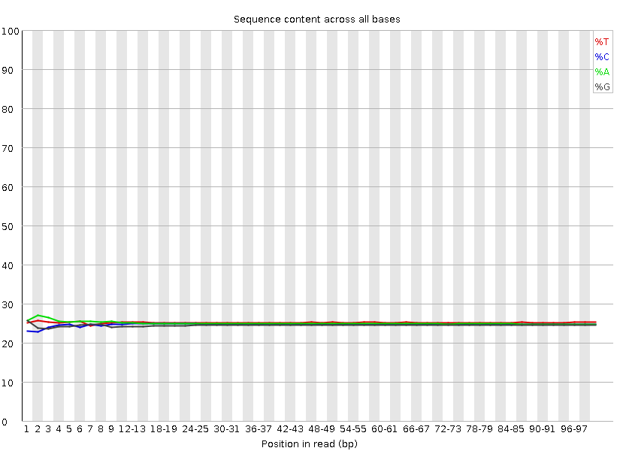
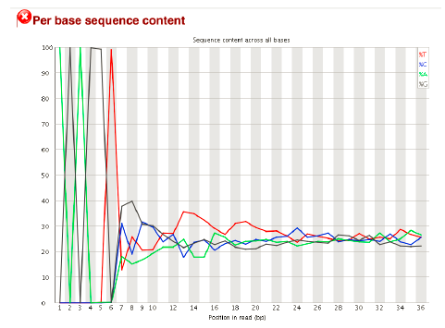
Per base sequence content
Sequencing targets and library protocol-dependent
Abnormal base composition (Adapter?)

Slide 38
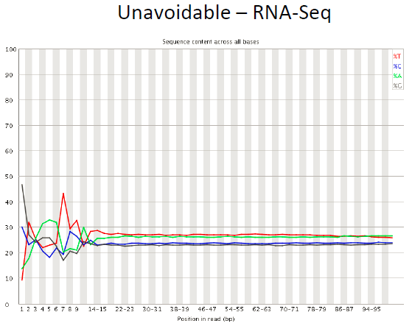
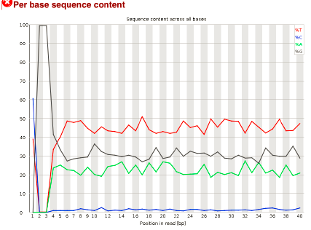
Per base sequence content
Simon Andrews

Slide 39
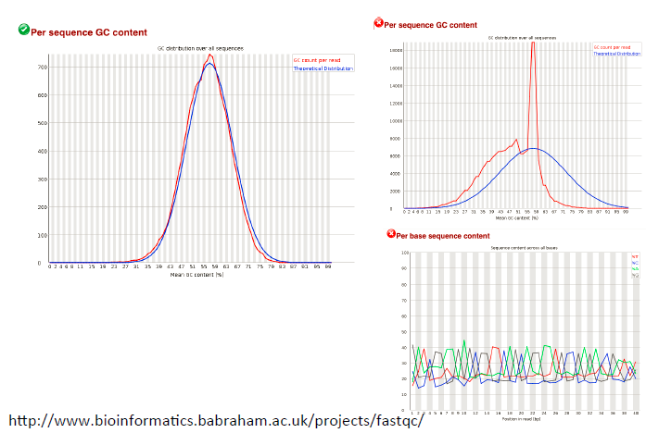
Per sequence GC content
Sequencing targets and library protocol-dependent

Slide 40
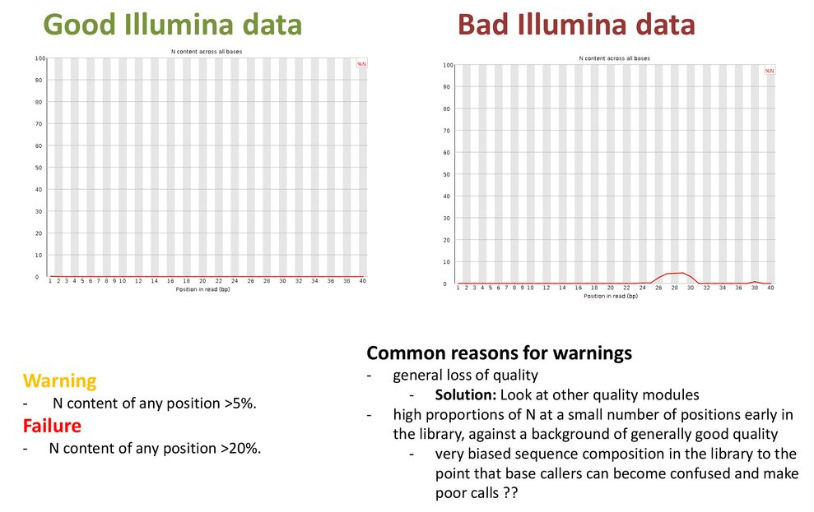
Per base N content
https://slideplayer.com/slide/13772534/

Slide 41
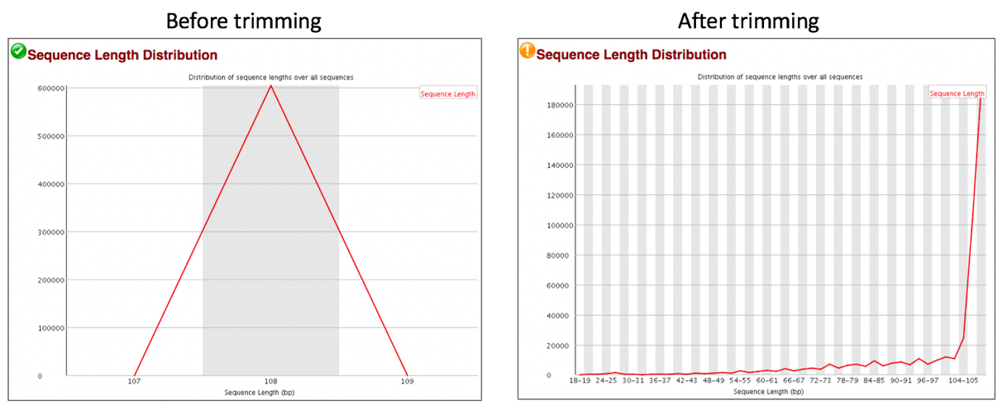
Sequence length distribution
https://docs.patricbrc.org/tutorial/fastq-utilities/fastq-utilities.html

Slide 42
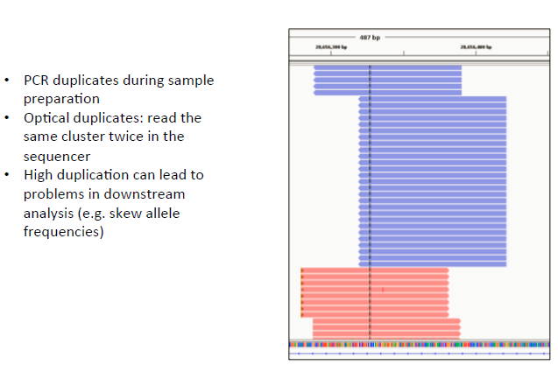
Duplicate sequence

Slide 43
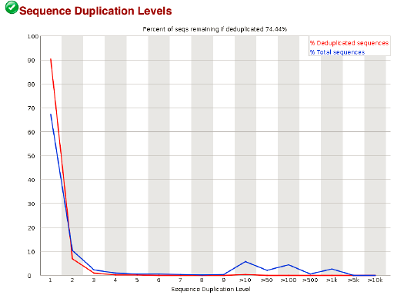
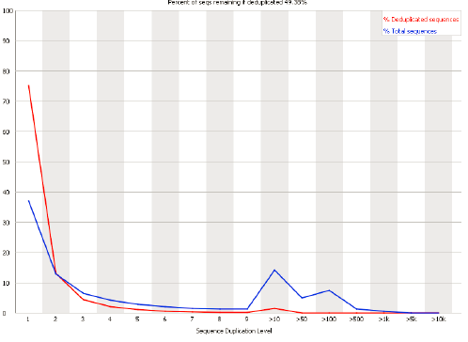
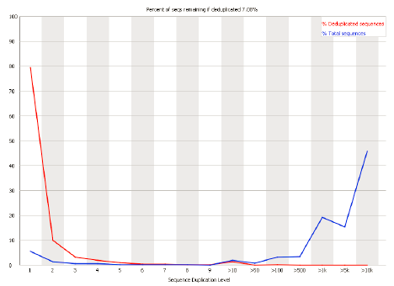
Duplicate sequence
High complexity
High PCR duplication rate

Slide 44
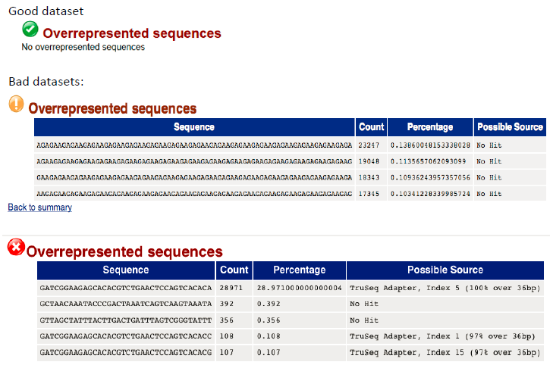
Overrepresented sequences
Nextseq produce lots of polyG reads: (see https://www.dna-ghost.com/single-post/2018/01/23/Be-careful-the-poly-G-sequence-from-NextSeq-run)

Slide 45
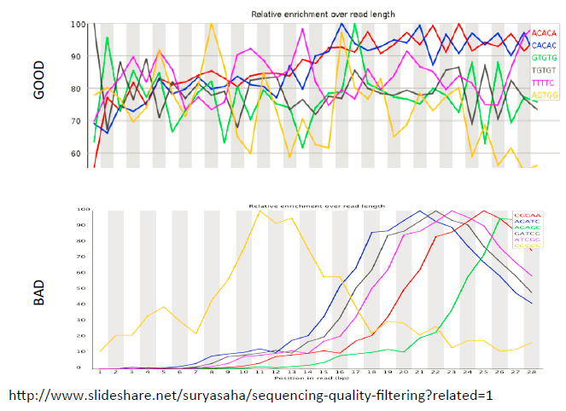
K-mer contents

Slide 46
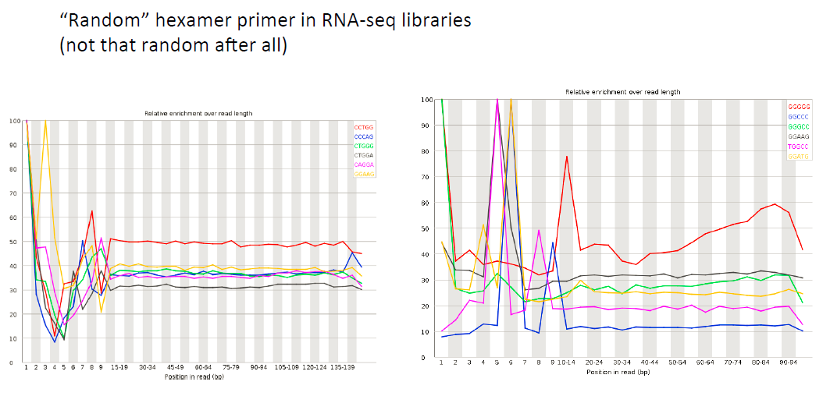
K-mer contents
Further Reading:
Biases in Illumina transcriptome sequencing caused by random hexamer priming: Hansen et al. 2010. https://academic.oup.com/nar/article/38/12/e131/2409775

Slide 47
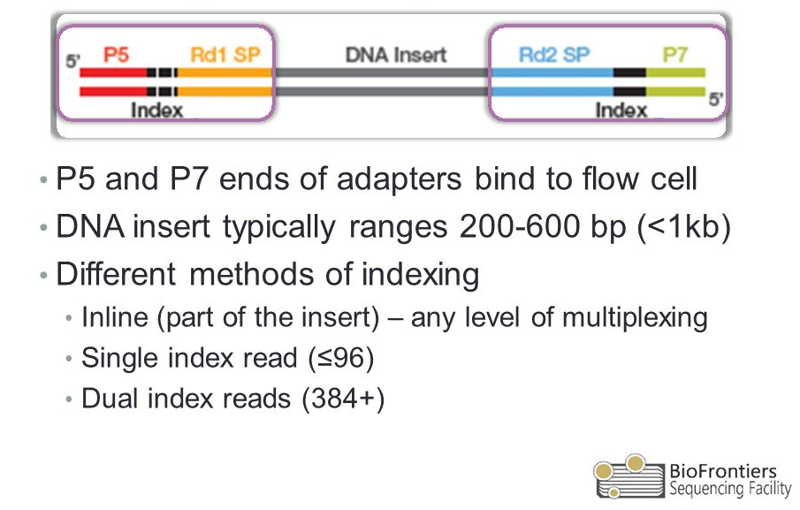
Adpater content
R1
R2
What if the insert is shorter than proposed sequencing length?

Slide 48
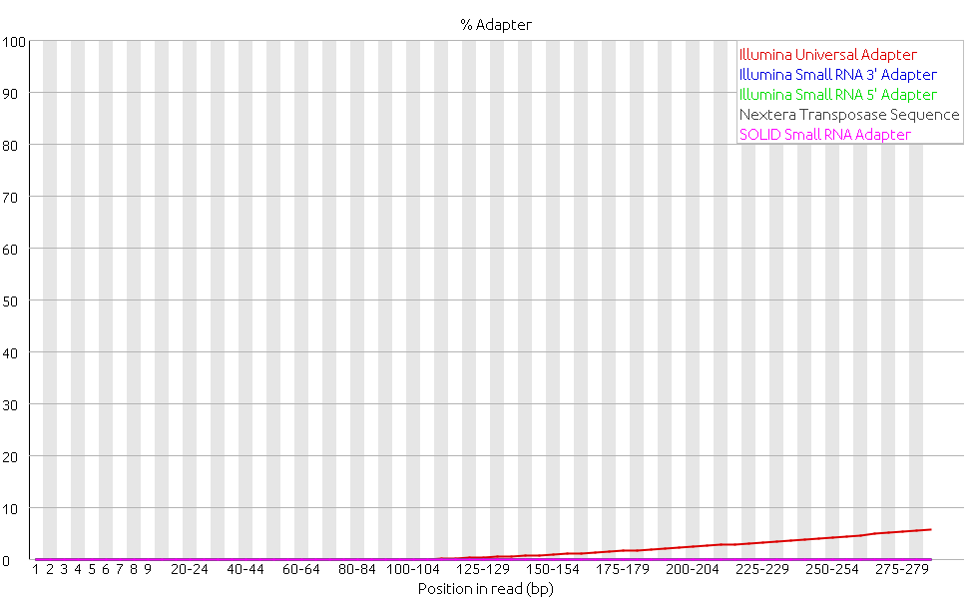
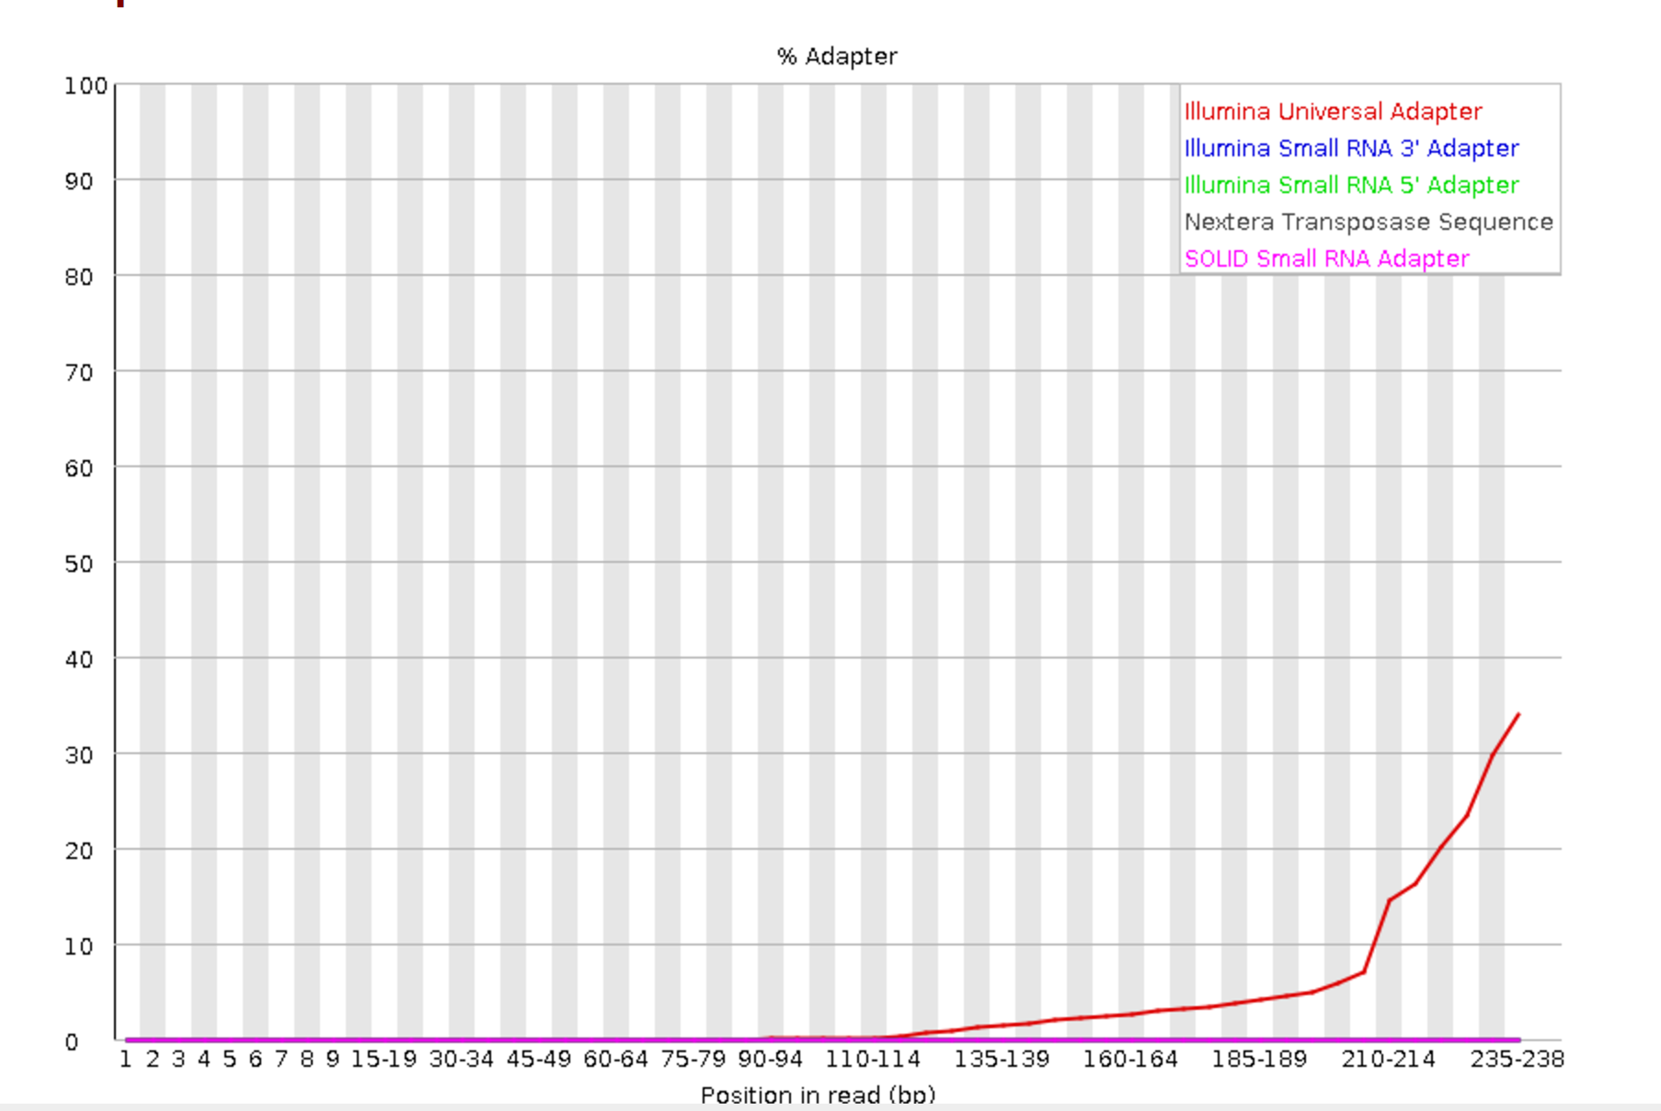
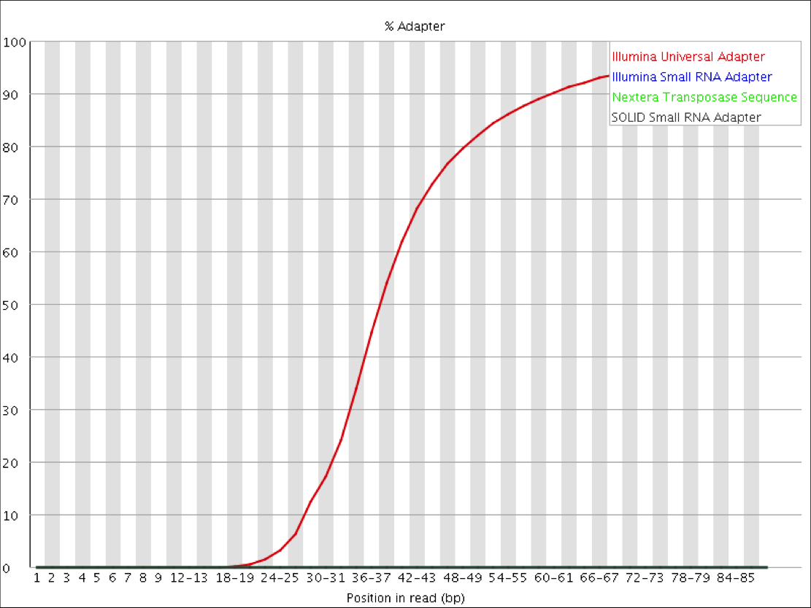
Adapter content

Slide 49
Further reading on QC
• Zhou, X., & Rokas, A. (2014). Prevention, diagnosis and treatment of high-throughput sequencing data pathologies. Molecular Ecology, 23(7), 1679–1700. https://doi.org/10.1111/mec.12680
• https://rtsf.natsci.msu.edu/genomics/tech-notes/fastqctutorial-and-faq
• https://sequencing.qcfail.com/
• https://www.bioinformatics.babraham.ac.uk/projects/fastqc/Help/

Slide 50
Challenges in mapping short reads
• Reads are short (50-150 bases)
• Large number of reads (hundreds of millions)
• Many pieces don’t fit:
• sequencing error/SNP/structural variant
• Many pieces fit in many places (multi-mappers):
• low complexity region/microsatellite/repeat
• Imperfect reference genome
• Many reads span exon-exon junctions (RNA-seq)

Slide 51
Alignment/mapping tools for short reads
DNA aligners
Bowtie (Langmead 2011; http://bowtie-bio.sourceforge.net/index.shtml), Bowtie2 (Langmead and Salzberg, 2012; http://bowtie-bio.sourceforge.net/bowtie2/index.shtml)
BWA: http://bio-bwa.sourceforge.net/
RNA aligners
HISAT2(successor of TopHat2)
GSNAP
STAR
Quasi-aligner for RNA-seq quantification
Salmon:
quasi-mapping or precomputed alignment-informed
GC-bias-aware
Better accuracy, 10X faster, less memory
Further reading: Patro et al. Salmon provides fast and bias-aware quantification of transcript expression. Nat Methods 14, 417–419 (2017) doi:10.1038/nmeth.4197
Further reading: Short Read Mapping: An Algorithmic Tour
https://www.ncbi.nlm.nih.gov/pmc/articles/PMC5425171/

Slide 52
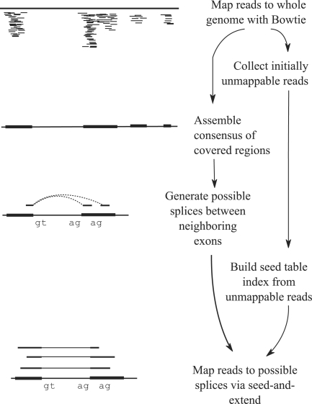
Exon-first RNA-seq aligner
Trapnell et al. Bioinformatics. 2009 May 1; 25(9): 1105–1111.

Slide 53
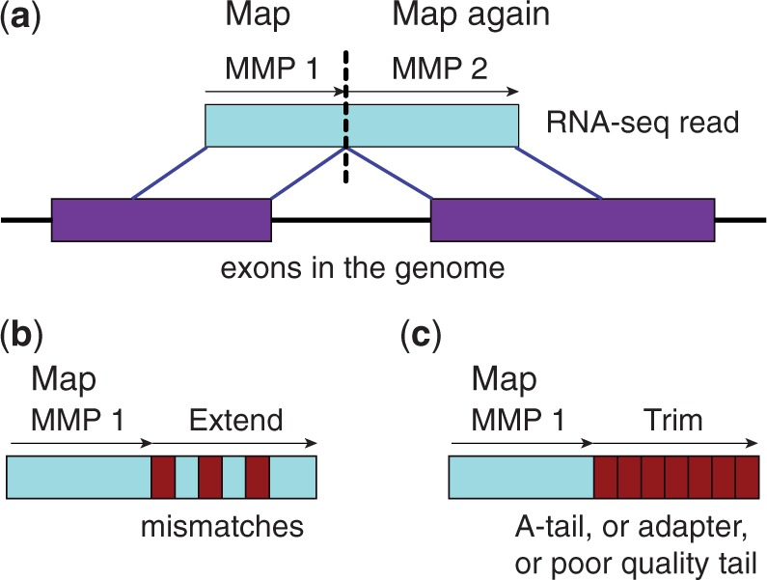
Seed-and-extend aligner (Better)
Further explanation: Dobin et al. Bioinformatics. 2013 Jan; 29(1): 15–21.
https://hbctraining.github.io/Intro-to-rnaseq-hpc-O2/lessons/03_alignment.html

Slide 54
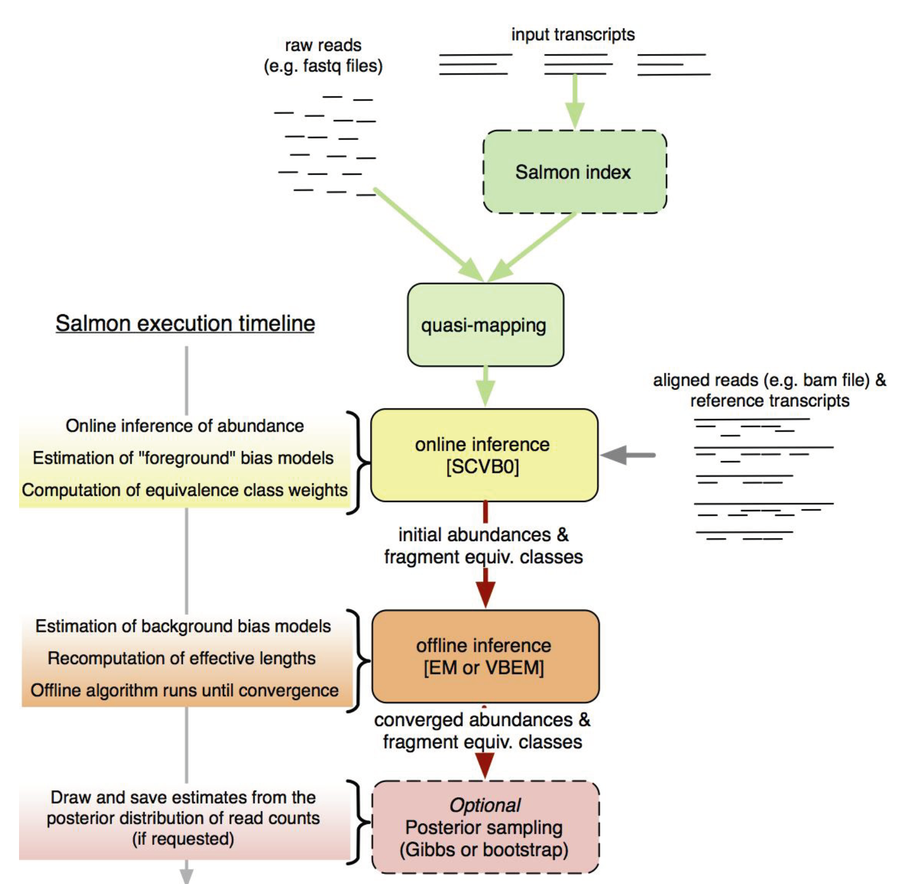
Salmon quasi-mapping framework
Patro et al Nat Methods 14, 417–419 (2017)

Slide 55
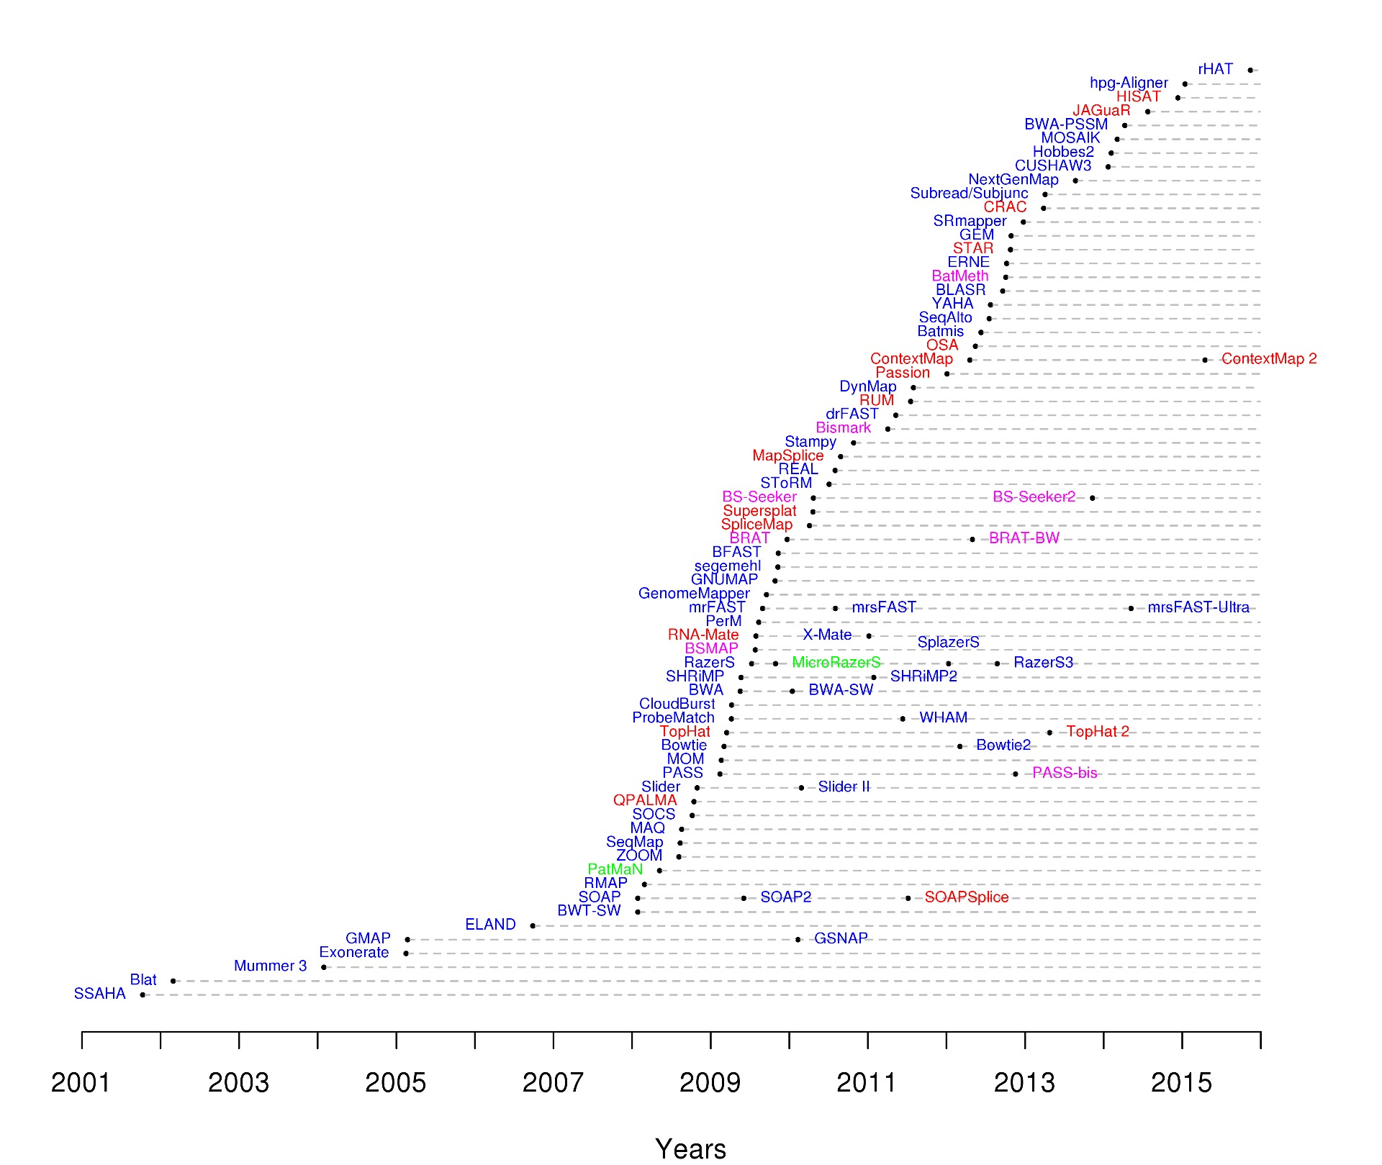
A large collection of Short Read Aligners (> 90)
DNA mappers
RNA mappers
miRNA mappers
Bisulfite mappers
Grey dash lines connect related mappers (extensions or new versions)
Modified on Fonseca at al, 2012. Bioinformatics. 28: 3169-3177

Slide 56
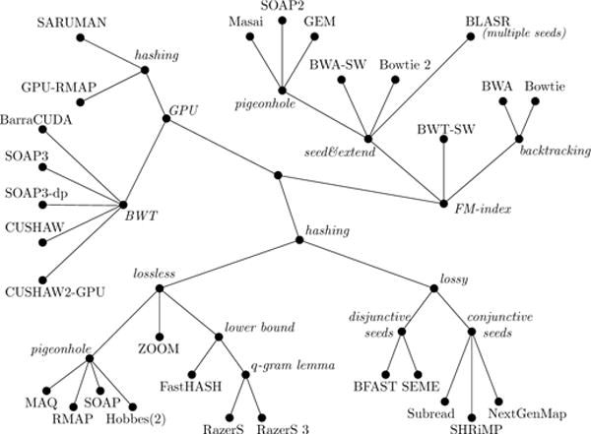
Genealogical relationship between aligners
https://www.ncbi.nlm.nih.gov/pmc/articles/PMC5425171/

Slide 57
Further reading on NGS mappers
Reinert et al. 2015; https://doi.org/10.1146/annurev-genom-090413-025358
Li et al. 2010; doi: 10.1093/bib/bbq015
Selection of NGS mapper: https://www.ecseq.com/support/ngs/what-is-the-best-ngs-alignment-software

Slide 58
Tools for manipulating alignment files
SAMtools
http://www.htslib.org/doc/samtools.html
https://davetang.org/wiki/tiki-index.php?page=SAMTools
Sambamba
https://lomereiter.github.io/sambamba/
Novosort: handle very big BAM files (> 100 GB)
http://www.novocraft.com/products/novosort/
Picard tools
https://broadinstitute.github.io/picard/
Bedtools
http://quinlanlab.org/tutorials/bedtools/bedtools.html
Bamtools
https://github.com/pezmaster31/bamtools/wiki

Slide 59
Functionalities in samtools
Usage: samtools <command> [options]
view
sort
merge
split
index
dict
mpileup
addreplacerg
faidx/fqidx
idxstats
flagstats
stats
bedcov
depth
fastq/fasta
fixmate
quickcheck
markdup
For detailed tutorial, see http://www.htslib.org/doc/samtools.html

Slide 60
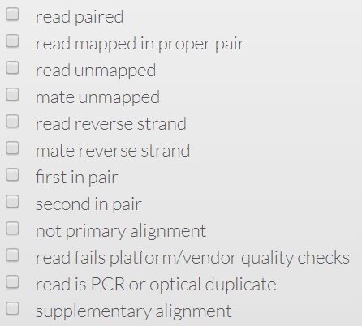

SAM FLAGs: Alignment status
Decoding SAM FLAGs: https://broadinstitute.github.io/picard/explain-flags.html
Explanation to Linear, Chimeric, Supplementary, Primary and Secondary Alignments
https://yulijia.net/en/bioinformatics/2015/12/21/Linear-Chimeric-Supplementary-Primary-and-Secondary-Alignments.html

Slide 61
NGS data visualization
Integrative Genomics Viewer (IGV): http://software.broadinstitute.org/software/igv/
local installation, fast, easy to use
UCSC genome Browser: https://genome.ucsc.edu/cgi-bin/hgGateway
Remote server, data-rich
R packages: http://www.sthda.com/english/wiki/visualize-ngs-data-with-r-and-bioconductor
Targeted genomic regions, publication-quality figures
Epiviz: https://epiviz.github.io/

Slide 62

Where should I ask for help?
(Slides from Joanna Krupka)

